Slide 1
Alpha University Fundraising System
Group 7: Diana Cesar, Ashley Mikel, & Cameren Sudduth

Slide 2
Alpha University Fundraising Objectives
Support fundraising efforts and manage donations efficiently
Track donors and their affiliations (alumni, parents, staff, etc.)
Record pledges, payments, and installment schedules
Personalize communication (letters, reminders)
Monitor donor categories and “donor circles”
Generate reports for planning and annual summary

Slide 3
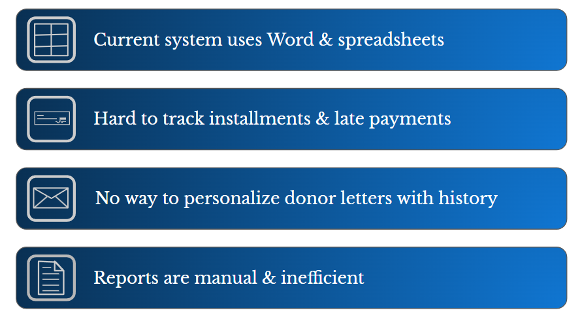
Why a Database Is Needed

Slide 4

Alpha Raises Funds
Personalized letters and online forms
Fundraising Events (carnival, dinner, golf outing, etc.)
Phonathon

Slide 5

Information Tracked
Donor forms: name, address, affiliation, class year
Pledge/Payment details: pledged, received, due date
Graduating Seniors List
Parents, Faculty, Staff Lists
Event & Matching Gift Lists

Slide 6
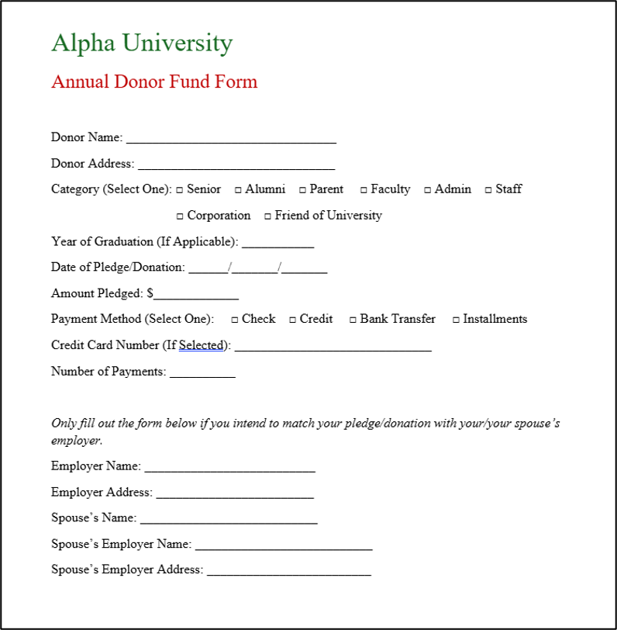

Slide 7
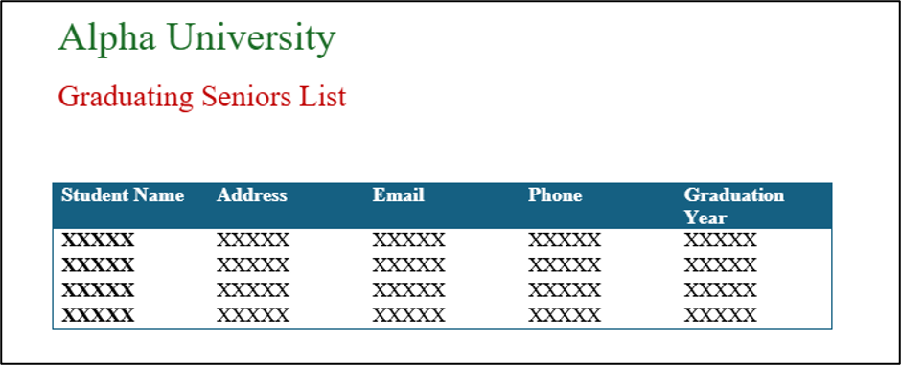

Slide 8
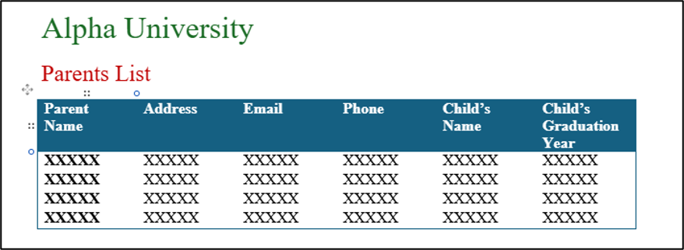

Slide 9
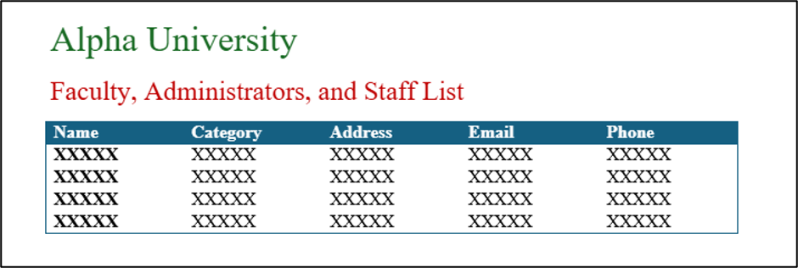

Slide 10
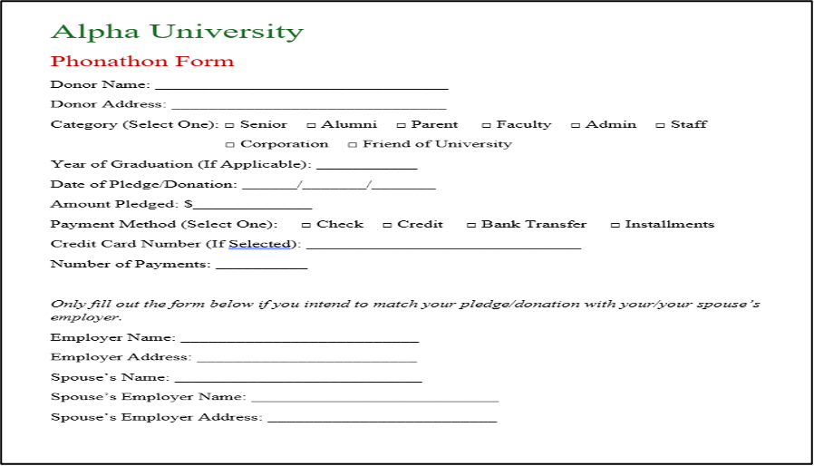

Slide 11
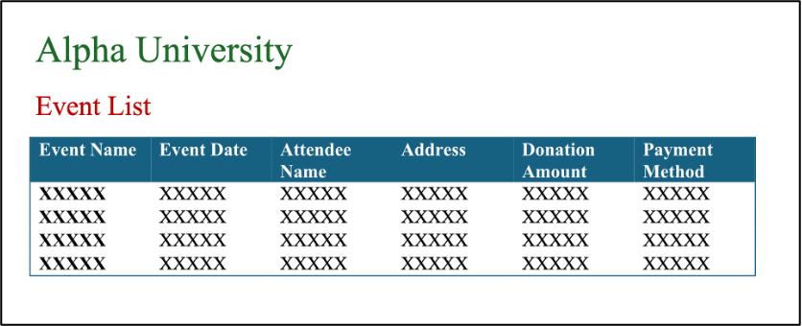

Slide 12
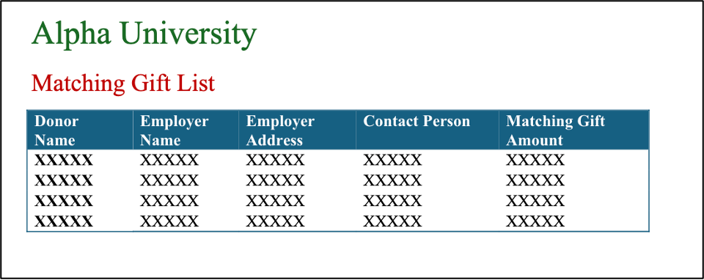

Slide 13
Reports Generated
Annual Report: donors by category/circle
Monthly Report: pledges, gifts, % breakdown
Payments Due Report: overdue installments
Event Report: track event success
Class Representative Contact List: contact classmates
Phonathon Volunteer Contact List: track donors from phonathon

Slide 14
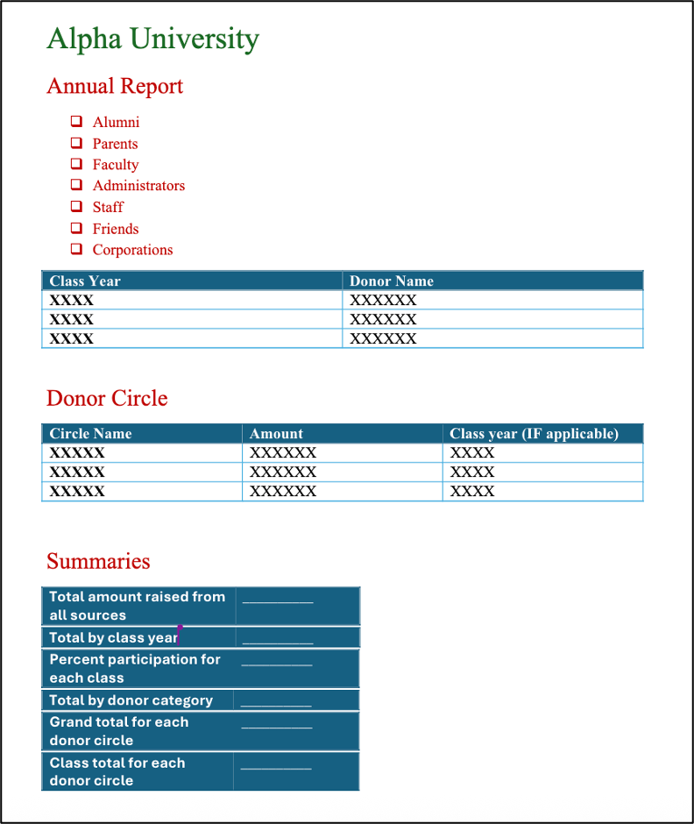

Slide 15
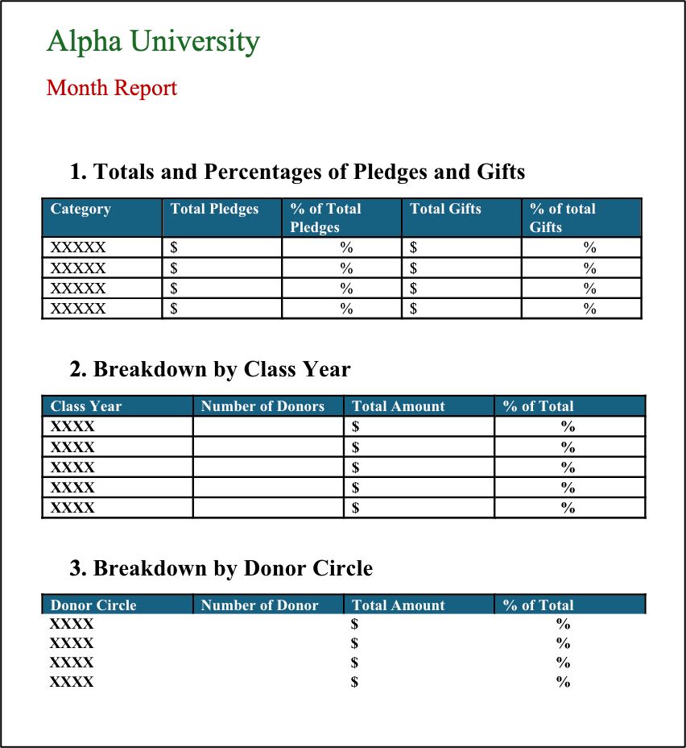

Slide 16
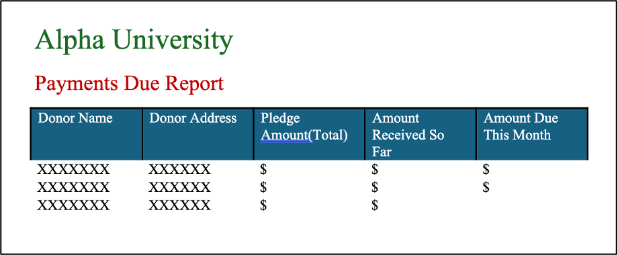

Slide 17
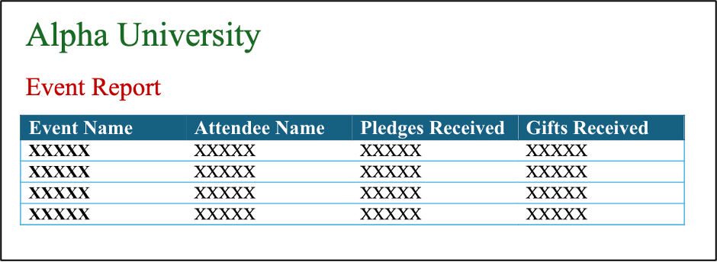

Slide 18
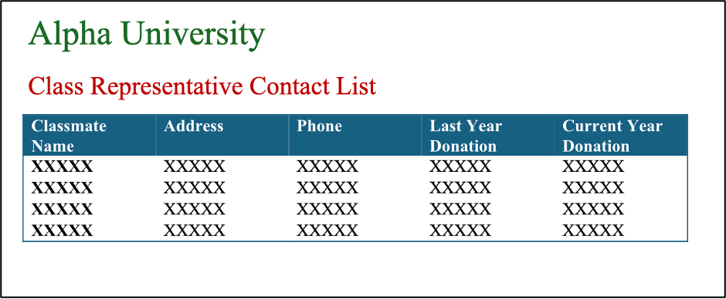

Slide 19
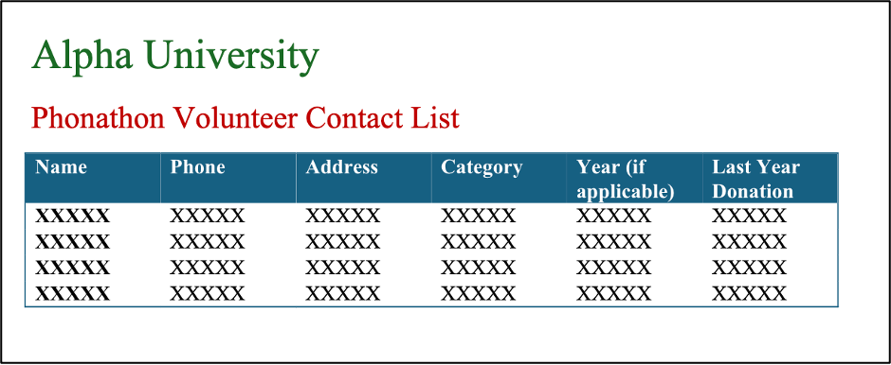

Slide 20
Database Transactions
Find donor history
List overdue payments
View event participation
Generate class/phonathon contact lists
Find matching gifts

Slide 21
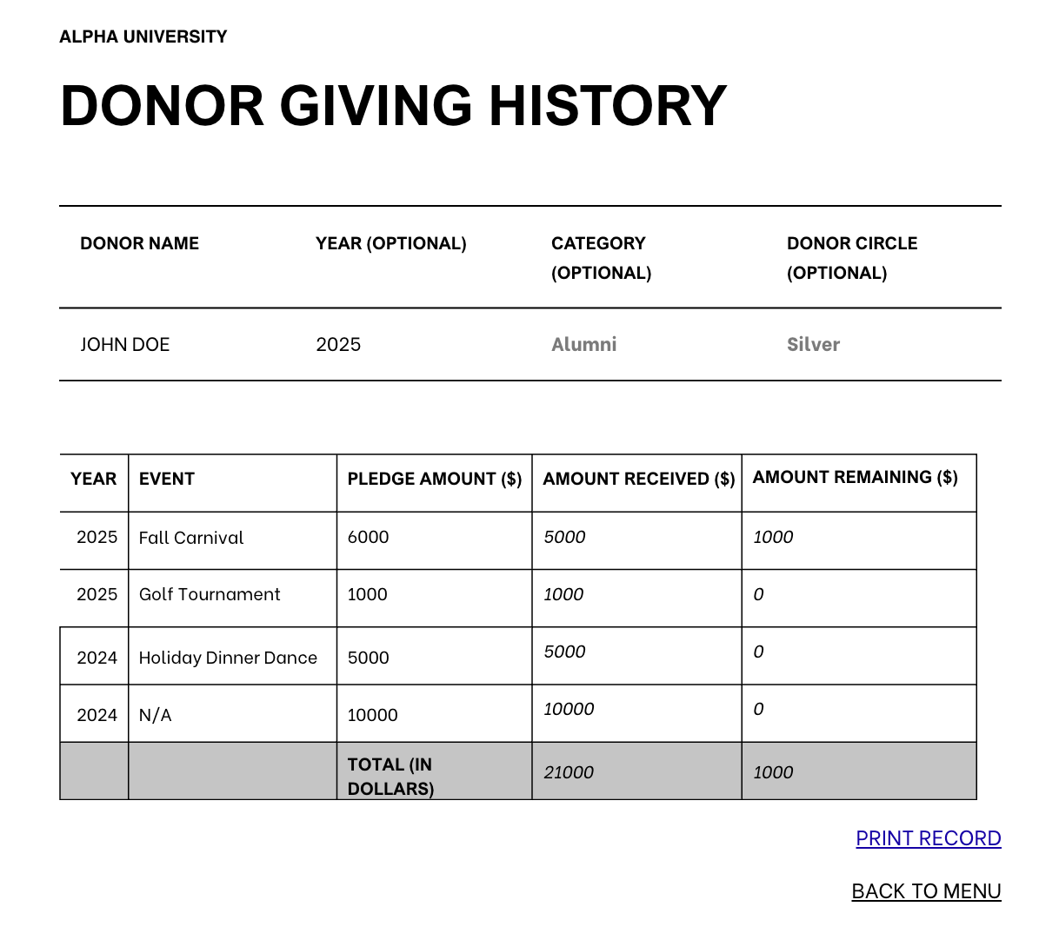

Slide 22
Organizing the Data
(Data Dictionary)
Defines each data item clearly
Examples:
  donorName: Name of donor
  amountPledged: Total committed
  circleName: Donor circle
  percentParticipation: % of donors giving

Slide 23
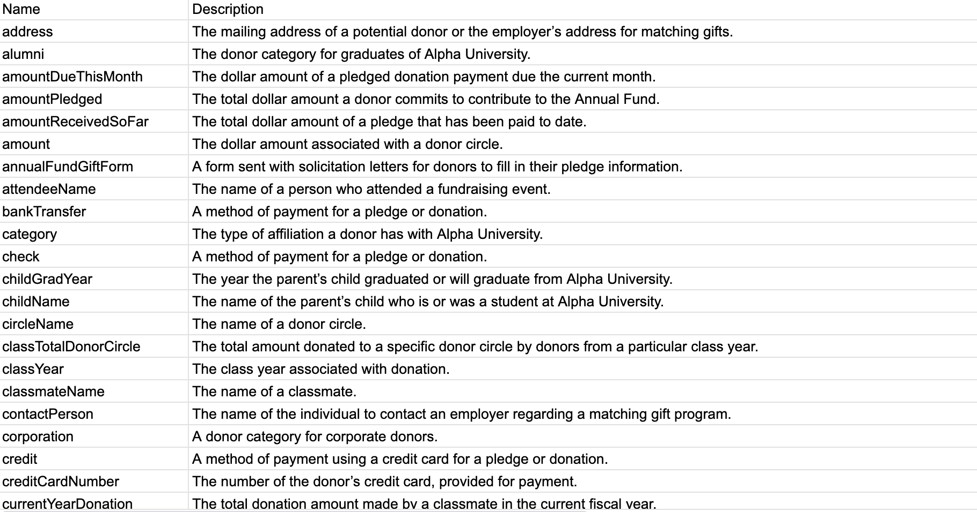

Slide 24
Cross-Reference Table
Links data items to forms, reports, transactions
Ensures coverage & consistency
Example: address appears across donor form, parents form, phonathon form, etc.

Slide 25
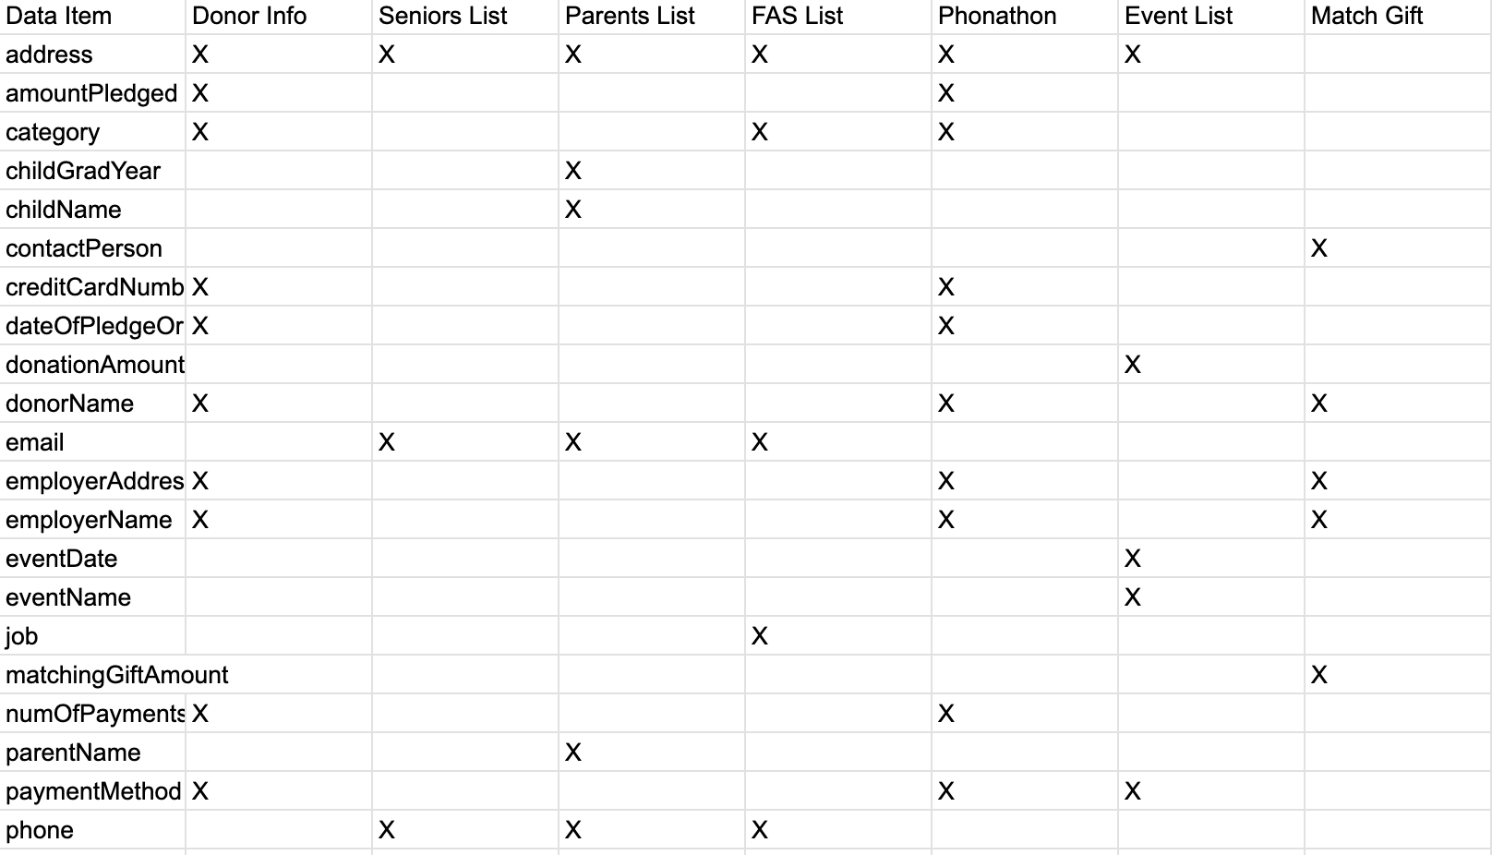

Slide 26
Project Timeline
Clear milestones & responsibilities
Identify forms, reports, transactions
ER & EER models → relational database
Normalization & schema creation

Slide 27
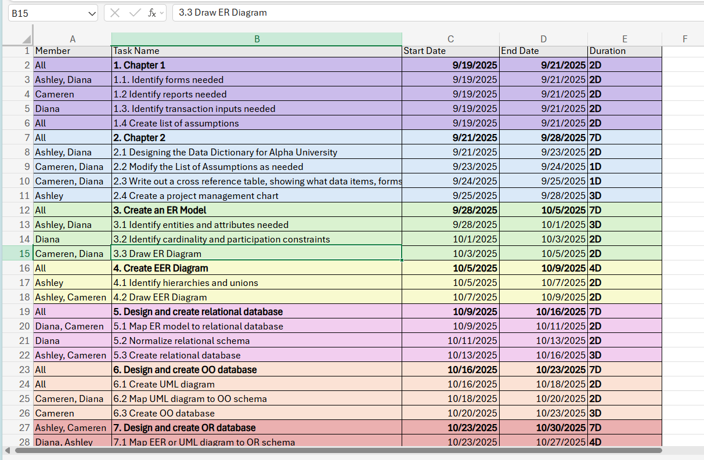

Slide 28

Transforming Fundraising with Data
From manual chaos → Automated database system
Benefits:
- Better donor communication
- Automated reporting & tracking
- Smarter fundraising strategy

